Slide 1
Ethics and Statistics
Jouko Miettunen, Professor, Academy Research Fellow
Center for Life Course Health Research
University of Oulu
jouko.miettunen@oulu.fi

Slide 2
CONTENTS
Ethical guidelines
Errors in statistics
Test assumptions
Multiple testing
Power and attrition
Clinical trials
Publication bias
References

Slide 3
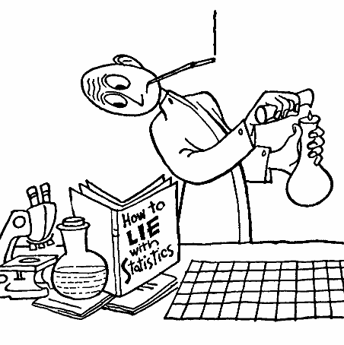
Misuses of statistics may (or may not) violate several ethical obligations, such as the duty to be honest, the duty to be objective, the duty to avoid error, and, possibly, the duty to be open?
Poor statistics → poor science!
Gardenier and Resnik 2002

Slide 4
Misuse of statistics – why?
Pressures to publish, produce results, or obtain grants
Career ambitions or aspirations
Conflicts of interest and economic motives
Inadequate supervision, education, or training
Gardenier and Resnik 2002

Slide 5
Ethical guidelines for statistical practice
present findings and interpretations honestly and objectively
avoid untrue, deceptive, or undocumented statements
disclose any financial or other interests that may affect the professional statements
collect only the data needed for the purpose of the inquiry
protect the confidentiality of information
ensure that, whenever data are transferred to other persons or organizations, this transfer conforms with the established confidentiality pledges, and require written assurance from the recipients of the data that the measures employed to protect confidentiality will be at least equal to those originally pledged
  Use filesender programs and engagement forms
American Statistical Association 1999 (www.amstat.org)

Slide 6
Ethical guidelines for statistical practice
Be prepared to document data sources used in an inquiry and known inaccuracies in the data
Make the data available for analysis by other responsible parties
Recognize that the selection of a statistical procedure may to some extent be a matter of judgment
Recognizing that a client (researcher) or employer may be unfamiliar with statistical practice
Apply statistical procedures without concern for a favorable outcome
State clearly, accurately, and completely to a client the characteristics of alternate statistical procedures along with the recommended methodology and the usefulness and implications of all possible approaches

Slide 7
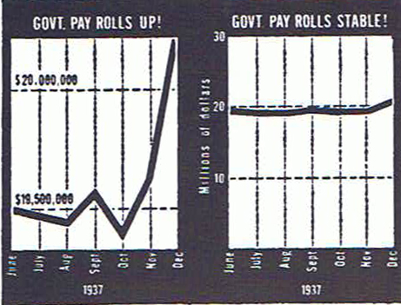


Slide 8
Errors in analyses
Easy to use incorrectly
Not always easy to detect
On purpose vs. not?
Who is doing analyses?
Differences in programs
How often?
Lang T. Twenty statistical errors even you can find in biomedical research articles. Croatian Med J 2004; 45:361-70.

Slide 9
Test assumptions
Normality
Visual check is important
Mean vs. Median
Assumption in regression analysis
Transformations
Can complicate interpretation
Osborne and Waters 2002

Slide 10
Test assumptions
Independence of observations
Unusual event if well designed study
In large studies usually not a problem
Reliability of measurements
Poor reliability reduces power
Osborne and Waters 2002

Slide 11
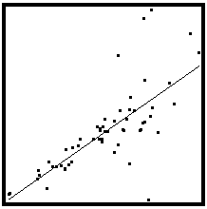
Test assumptions
Homoscedasticity
= variance should be the same across all levels of the variable
Assumed regression analysis
High heteroscedasticity decreases power
Osborne and Waters 2002

Slide 12
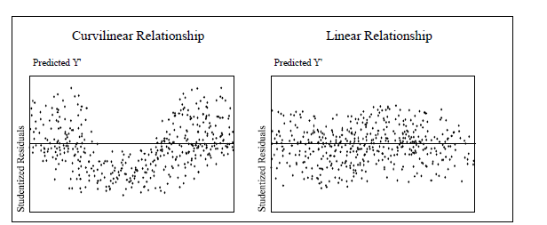
Test assumptions
Non-linear associations reduce power in standard multiple regression
Osborne and Waters 2002

Slide 13
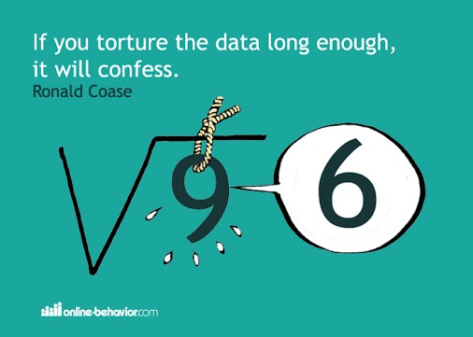
Multiple testing

Slide 14
Multiple testing
Setting hypotheses is important!
Data fishing
Corrections for multiple testings
  Bootstrapping methods
  Post-Hoc testing of ANOVAs
  Bonferroni correction
  Benjamini-Hochberg procedure

Slide 15

Bonferroni correction
Simple, but conservative methods
Level of statistical significance of p=0.05 will be changed by dividing it with number of tests
Example:
  25 tests
  Without correction 5 variables are significant (p<0.05)
  With corrected level (p<0.002) one significant variables

Slide 16

Benjamini-Hochberg correction
Q=0.25
Q=0.05
0.002
0.004
0.006
0.008
(i)
Significances are ranked by order (Rank, i)
Benjamini-Hochberg critical value is calculated with formula (i/m)Q, where i=rank, m=# of tests ja Q=selected false discovery rate (how many false positive findings are accepted)
Example: Q=0.25 (often Q=0.05)
In the example, first 5 are significant (even ”whole milk” and ”white meat” although P > critical value, as P smaller than P in variable ”proteins”)

Slide 17
Interpretation
Statistical significance vs. effect?
“The difference between ‘significant’ and ‘not significant’ is not itself statistically significant”
”Absence of evidence is not evidence of absence

Slide 18

Statistical Power

Slide 19
Power analyses
Well done sample size (power) analyses should be part of all study plans
Too much research done with small samples → ethical problem!

Slide 20
Power analyses
Samples sizes in clinical trials are usually small, e.g.
  Rheumatoid arthritis: median sample size 54 patients (196 trials)
  Skin diseases: 46 patients (73 trials)
  Schizophrenia: 65 patients (2000 trials)
Sample size is usually not based on anything!
Post hoc power calculations are unnecessary, confidence intervals tell about power
Moher et al. CONSORT statement 2010

Slide 21
Power analyses
Need to know
Number of persons
Prevalence of the primary outcome (expected number of events)
Assumptions to be made
Effect size
Significance level (α)
Statistical power (1-β)

Slide 22
Alpha i.e. significance level (e.g. 0.05 or 5%)
Probabibility that difference is found but it is not real (false positive finding)
Beta i.e. power (e.g. 0.8 or 80%)
Probability that the found difference is real
Interim analysis is a a priori planned analyses done in an ongoing trial, reasons for this ethical or economical
α – error increases
Power can be inadequate?
Suresh KP & Chandrashekara S. J Hum Reprod Sci 2012; 5: 7–13.

Slide 23
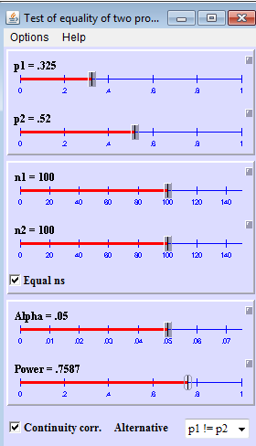
Different situations
Difference in means
Difference in proportions
Multiple variable analyses
Different software
Web pages
Specific software
SPSS sample power, …
http://homepage.stat.uiowa.edu/~rlenth/Power/index.html

Slide 24
Study design
In clinical trials smaller sample size is adequate
Variance
Larger variance requires larger sample sizes to detect group differences
Follow-up studies: take into account attrition!
Suresh KP & Chandrashekara S. J Hum Reprod Sci 2012; 5: 7–13.

Slide 25

Attrition
Patients and doctors participate poorly to clinical trials.
Doctors want to decide about the treatment of their patients.
Believe to standard care is strong!
If <80% included in the final analyses, the results should not be taken into account (EBM toolkit 2006).

Slide 26
Lieberman JA, et al. Antipsychotic drug effects on brain morphology in first-episode psychosis. Arch Gen Psychiatry. 2005;62:361-70.
OBJECTIVE:
To test a priori hypotheses that olanzapine-treated patients have less change over time in whole brain gray matter volumes and lateral ventricle volumes than haloperidol-treated patients.
DESIGN:
Longitudinal, randomized, controlled, multisite, double-blind study. Patients treated and followed up for up to 104 weeks. Neurocognitive and magnetic resonance imaging (MRI) assessments performed at weeks 0 (baseline), 12, 24, 52, and 104.
INTERVENTIONS:
Random allocation to a conventional antipsychotic, haloperidol (2-20 mg/d), or an atypical antipsychotic, olanzapine (5-20 mg/d).
RESULTS:
Of 263 randomized patients, 161 had baseline and at least 1 postbaseline MRI evaluation. Haloperidol-treated patients exhibited significant decreases in gray matter volume, whereas olanzapine-treated patients did not.
CONCLUSIONS:
Haloperidol was associated with significant reductions in gray matter volume, whereas olanzapine was not. The differential treatment effects on brain morphology could be due to haloperidol-associated toxicity or greater therapeutic effects of olanzapine.

Slide 27
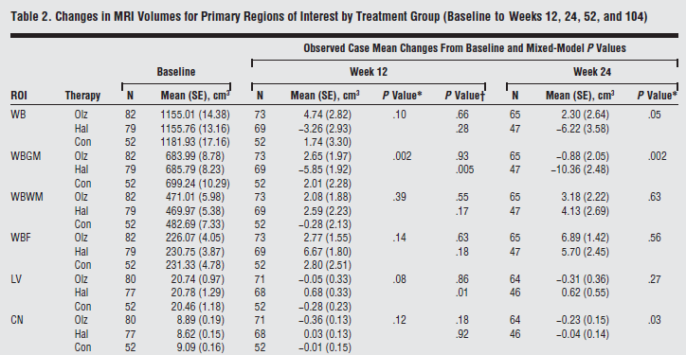
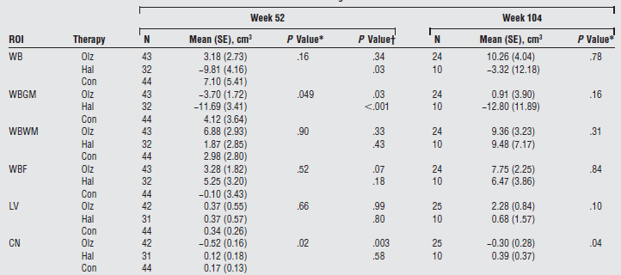
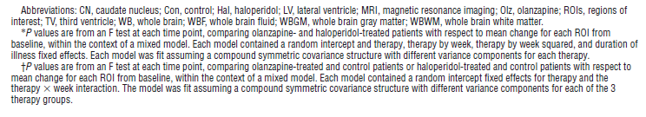
Lieberman JA, et al. Antipsychotic drug effects on brain morphology in first-episode psychosis. Arch Gen Psychiatry. 2005;62:361-70.

Slide 28
Missing data
People do not participate or are lost to follow-up?
Missing data on variables?
Can be a problem?
Describe? Analyze?
Take into account?
  Weighting? Multiple imputation?

Slide 29
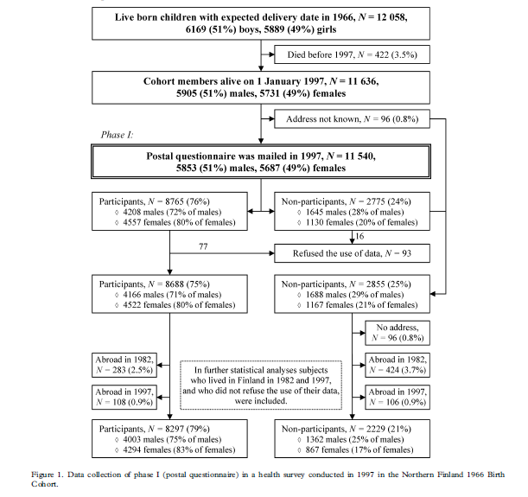
Flowchart

Slide 30
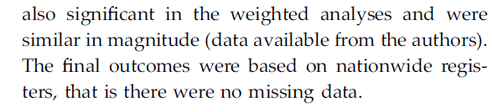
Reporting attrition
Miettunen J, Murray GK, Jones PB, Mäki P, Ebeling H, Taanila A, Joukamaa M, Savolainen J, Törmänen S, Järvelin MR, Veijola J, Moilanen I.
Longitudinal associations between childhood and adulthood externalizing and internalizing psychopathology and adolescent substance use.
Psychol Med. 2014 Jun; 44(8):1727-38.

Slide 31

Clinical trials

Slide 32
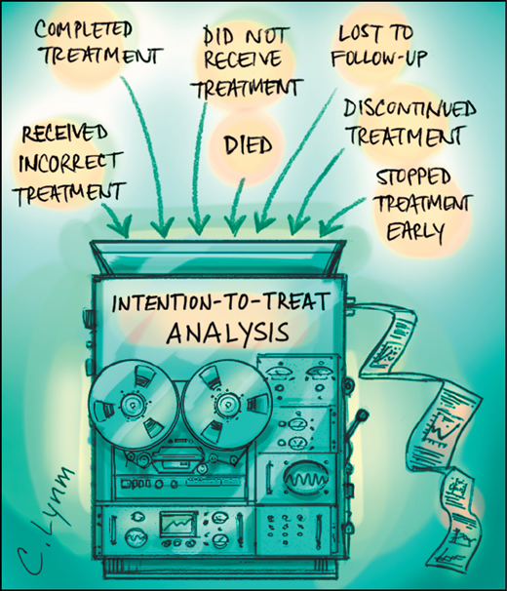
Intention-to-treat
Intention-to-treat analysis, i.e. the data is analyzed based on the original randomization
The effect of randomization remains!

Slide 33
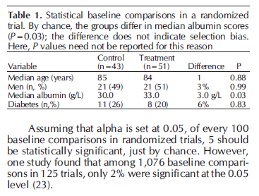
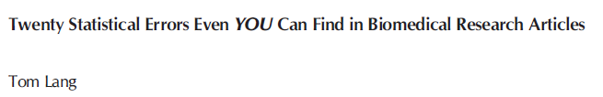
Tom Lang. Croatian Medical Journal 2004;45:361-70
- if a predictor, can be used as a covariate in analyses

Slide 34
Methods
Selection of interventions
  Grounds for interventions?
  Length of the study?
  Generalizability?
Primary vs. secondary outcome
Subgroup analyses?

Slide 35
Results
Statistical methods should be clearly described
Confidence intervals should be the primary method to describe the certainty of the effect
exact p-values (not <0.05 etc.)

Slide 36
Discussion
Limitations?
Comparison to previous studies?
Generalizability?
Interpretation?
Conclusions?

Slide 37
Inadequate reporting of harms
Ioannidis JP, et al. Ann Intern Med 2004; 141:781-8.
1. Using generic or vague statements, such as “the drug was generally well tolerated” or “the comparator drug was relatively poorly tolerated.”
2. Failing to provide separate data for each study arm.
3. Providing summed numbers for all adverse events for each study arm, without separate data for each type of adverse event.
4. Providing summed numbers for a specific type of adverse event, regardless of severity or seriousness.
5. Reporting only the adverse events observed at a certain frequency or rate threshold (for example, >3% or >10% of participants).
6. Reporting only the adverse events that reach a P value threshold in the comparison of the randomized arms (for example, P > 0.05).
7. Reporting measures of central tendency (for example, means or medians) for continuous variables without any information on extreme values.
8. Improperly handling or disregarding the relative timing of the events, when timing is an important determinant of the adverse event in question.
9. Not distinguishing between patients with 1 adverse event and participants with multiple adverse events.
10. Providing statements about whether data were statistically significant without giving the exact counts of events.
11. Not providing data on harms for all randomly assigned participants.
To study adverse effects, one can utilize observational studies!

Slide 38
Examples of poor reporting of non-significant results
a clear, strong trend (p=0.09)
an encouraging trend (p<0.1)
an important trend (p=0.066)
approached conventional levels of significance (p<0.10)
below (but verging on) the statistical significant level (p>0.05)
failed to reach significance on this occasion (p=0.09)
flirting with conventional levels of significance (p>0.1)
leaning towards significance (p=0.15)
narrowly escaped significance (p=0.08)
not conventionally significant (p=0.089), but..
not significant in the narrow sense of the word (p=0.29)
on the very fringes of signiﬁcance (p=0.099)
http://mchankins.wordpress.com/2013/04/21/still-not-significant-2/

Slide 39
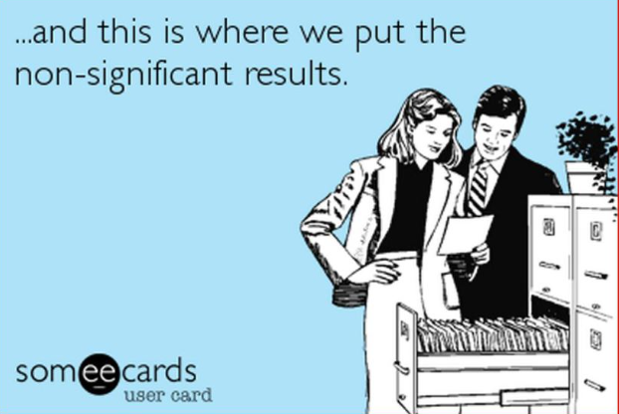

Slide 40
Meta-analyses
Publication bias can be estimated with a funnel plot
We assume that the most exact (usually largest) studies get average results, smaller studies should be in both sizes of the average
”Trim and fill”
Rosenberg. Evolution 2005;59: 464-8

Slide 41
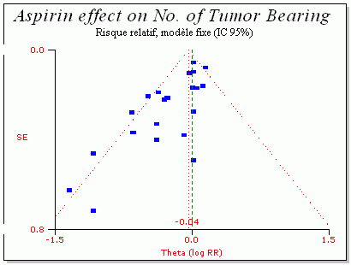
Funnel plot
Corpet & Pierre Eur J Cancer 2005 (http://corpet.free.fr/MAaspirin.html)

Slide 42
Trim and Fill
Method to correct for publication bias

Slide 43
Why most published research findings are false?
The smaller the studies conducted in a scientific field, the less likely the research findings are to be true.
The smaller the effect sizes in a scientific field, the less likely the research findings are to be true.
The greater the number and the lesser the selection of tested relationships in a scientific field, the less likely the research findings are to be true.
The greater the flexibility in designs, definitions, outcomes, and analytical modes in a scientific field, the less likely the research findings are to be true.
The greater the financial and other interests and prejudices in a scientific field, the less likely the research findings are to be true.
The hotter a scientific field (with more scientific teams involved), the less likely the research findings are to be true.
Ioannidis JPA. Why most published research findings are false. PLOS Medicine 2005;2:e124.

Slide 44
Some solutions ?
More teaching of statistics?
Guidelines?
Team work?
Registration of studies?
Publicly available data?
Sensitivity analyses?

Slide 45
Literature
Altman DG. Statistics and ethics in medical research. Misuse of statistics is unethical. Br Med J 1980; 281: 1182–4.
DeMets DL. Statistics and ethics in medical research. Science and Engineering Ethics 1999; 5:97-117.
Easterbrook PJ, et al. Publication bias in clinical research. Lancet 1991; 337:867–72.
Gardenier J & Resnik D. The misuse of statistics: concepts, tools, and a research agenda. Accountability in Research: Policies and Quality Assurance 2002; 9:65-74. Ioannidis JPA. Why most published research findings are false. PLOS Medicine 2005;2:e124.
Hutton JL. The ethics of randomised controlled trials: a matter of statistical belief? Health Care Anal 1996; 4:95-102
Lang T. Twenty statistical errors even you can find in biomedical research articles. Croatian Med J 2004; 45:361-70.

Slide 46
Literature
Ioannidis JPA. Why most published research findings are false. PLOS Medicine 2005;2:e124.
Mark DB, et al. Understanding the role of p values and hypothesis tests in clinical research. JAMA Cardiol. 2016; 1(9):1048-1054.
Moher D, et al. CONSORT 2010 explanation and elaboration: updated guidelines for reporting parallel group randomised trials. BMJ 2010; 340:c869.
Osborne JW & Waters E. Four assumptions of multiple regression that researchers should always test. Practical Assessment, Research, and Evaluation 2002: 8 (available online).
Palmer CR. Ethics and statistical methodology in clinical trials. J Med Ethics 1993; 19:219-22.
Suresh KP & Chandrashekara S. Sample size estimation and power analysis for clinical research studies. J Hum Reprod Sci 2012; 5: 7–13.

Slide 47
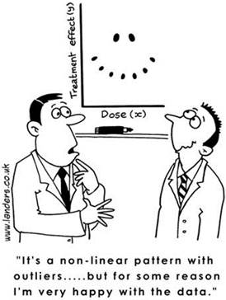
Thank you!
jouko.miettunen@oulu.fi
www.joukomiettunen.net

